Slide 1







Texture-Patch based evaluation of skin and eye surfaces from 3D facial Images
CIRB 2021/2419
Dev Patel

Slide 2
Introduction
Rare diseases is a disease that affects a small population less than 1 in 2000.
Osteogenesis Imperfecta (OI)
Rare Disease
Affects Bone strength and structure
Resulting in frequent fractures, chronic pain, and deformities
Spectrum of Mild and Severe

Slide 3
Problems – Osteogenesis Imperfecta
OI Patient Odyssey
Multiple healthcare providers
Imaging and genetic testing
No clear answers
Stigma and affect of schooling
Delays in Diagnosis
Lack of awareness or expertise among healthcare professional
Financial and Resource Burden on Both the healthcare providers and Family
Severe cases may be identified early
Milder ones can go undiagnosed until they have had fractures

Slide 4
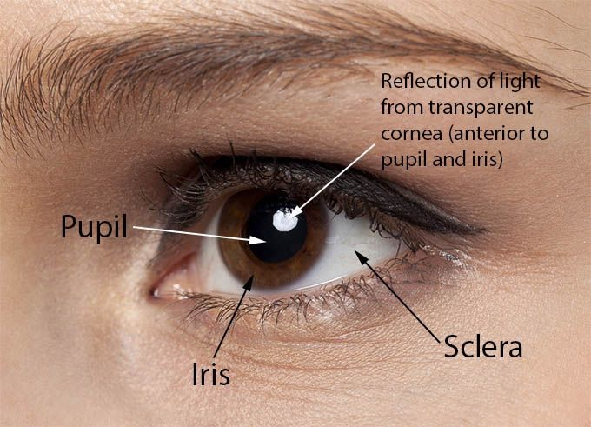
Our Approach
Osteogenesis Imperfecta
Sclera – the outer layer of the eye.
Blue or Greyish-Blue colour of sclera
Our Non-Invasive framework harnessing the Power Of AI
Face to Sclera's prediction
Through colour and texture of Sclera
Increases Efficiency in Providing Diagnosis
Versatile for detecting other conditions
Assumption:
Larger Dataset can be acquired later
Credit: Eye Bulletin

Slide 5
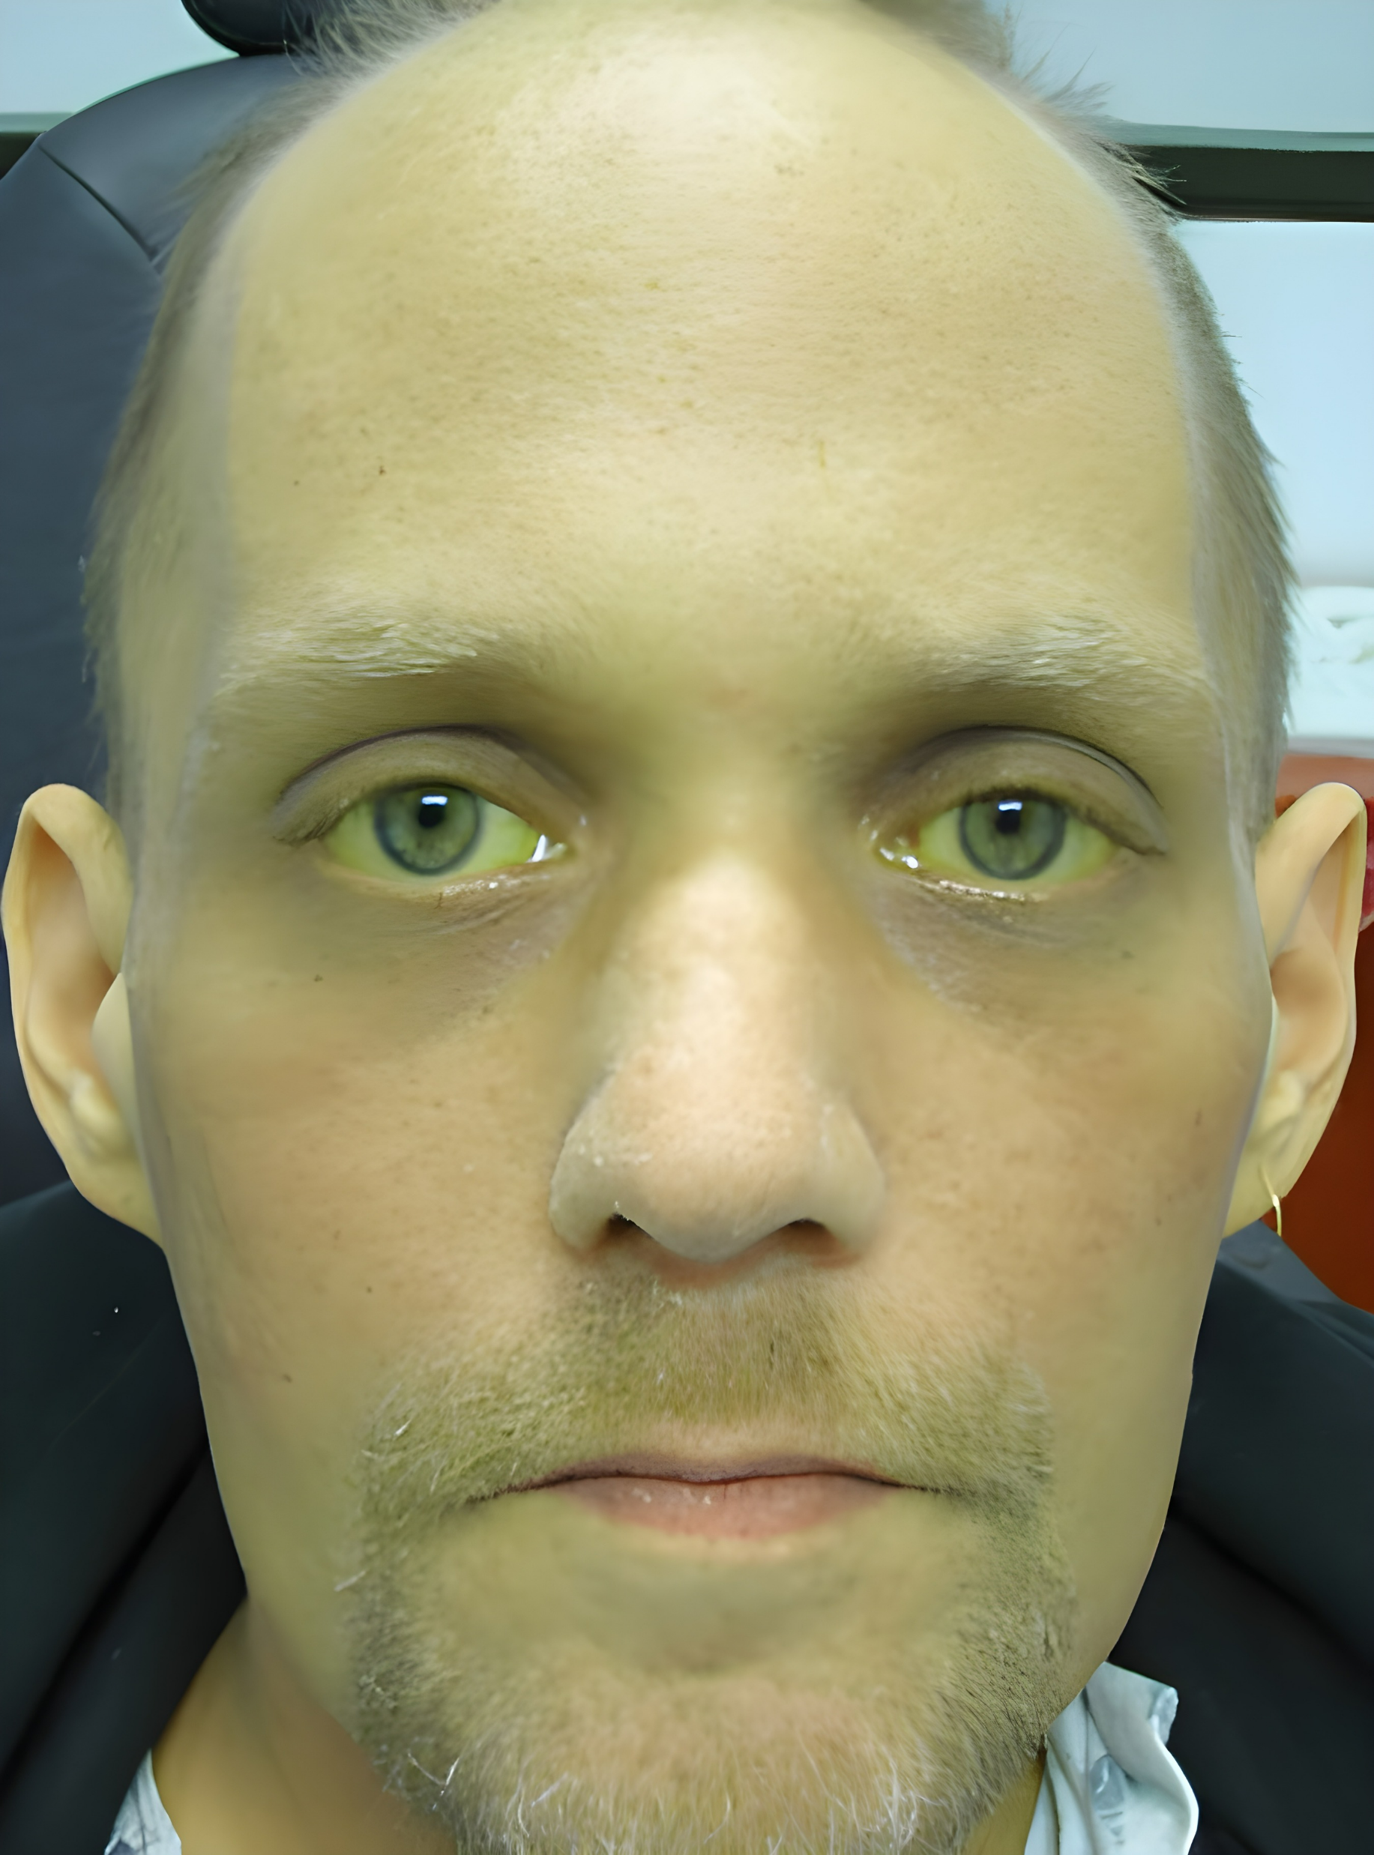
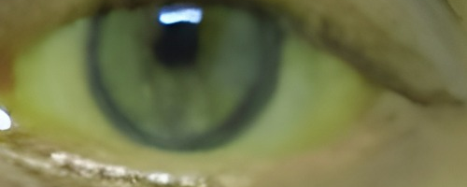


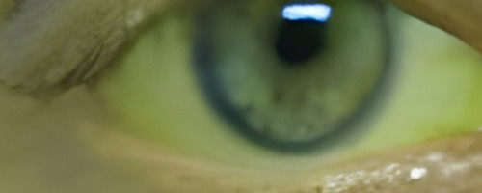
Region of Interest Extraction
Right Eye Crop
Two Strategies
OpenCV + Dlib through their face and landmark detection for KKH images
OpenCV’s bounding box method is for non-standardised images.
Left Eye Crop
Credit: Review of Optometry

Slide 6
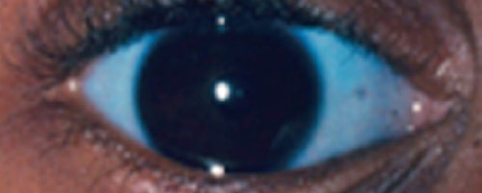
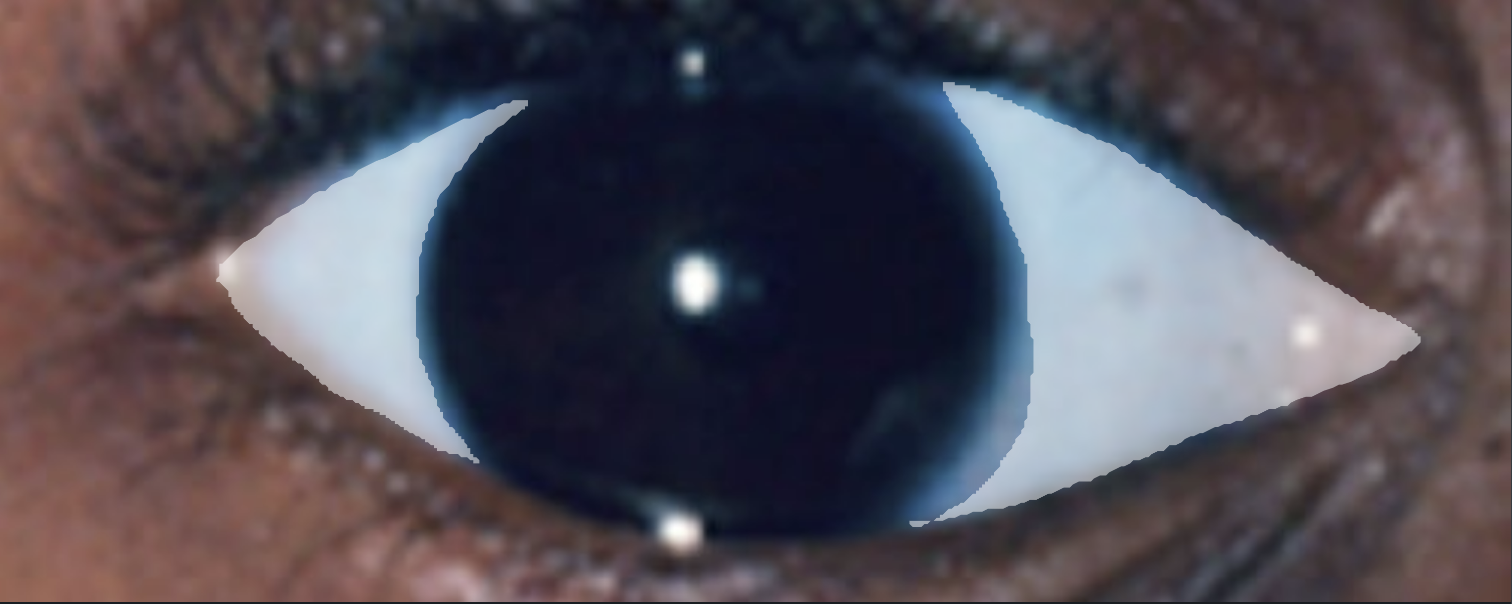

Data Annotation Process
Image Selection
Standardised Image – size & type
Eliminate bias – i.e., have different skin colours & shape
Annotation should be done by an expert
Total of 190 images ( 7 Jaundice and 10 Osteogenesis Imperfecta)
Eye Crop
Annotation
Ground Truth

Slide 7
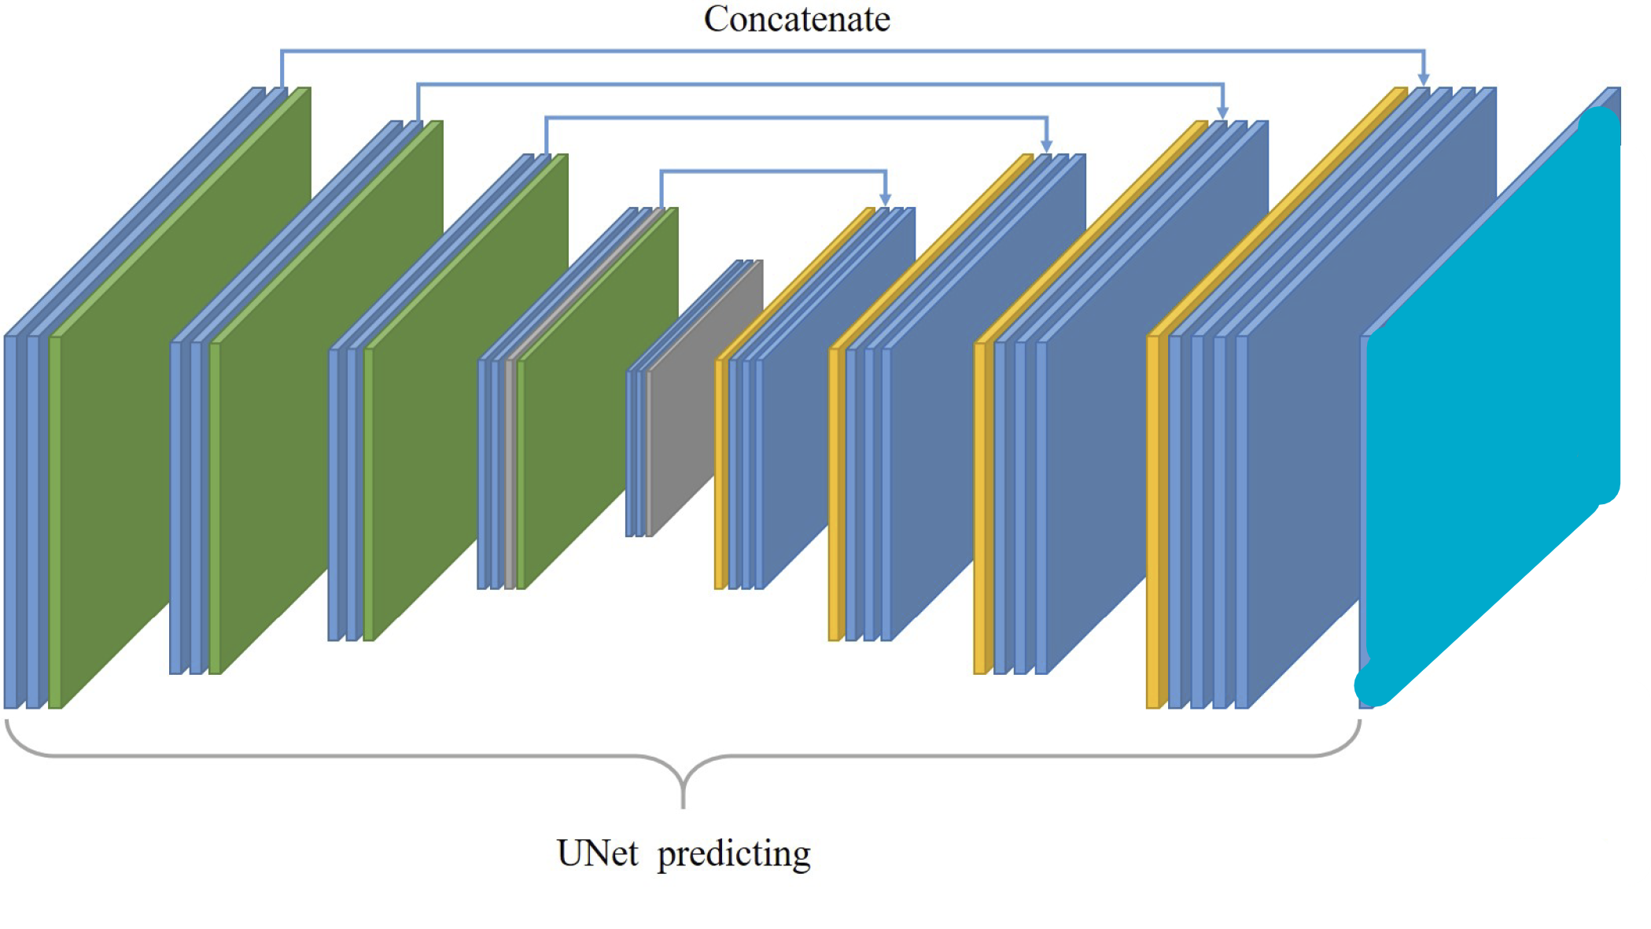

Sclera Extraction
Ground Truth
Uses UNet
Segmentation Network
Accuracy of 88%
Batch size: 19
Train: 80% & Validation: 20%
Predicted Mask

Slide 8
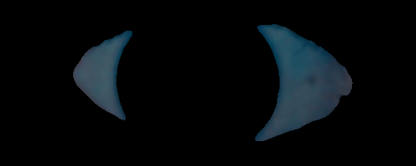
Sclera Extraction
Predicted Mask
OpenCV to map and merge the image
This completes the process of Sclera extraction
Alternative:
Use Canny Edge detector
Colour thresholds
Low Accuracy

Slide 9
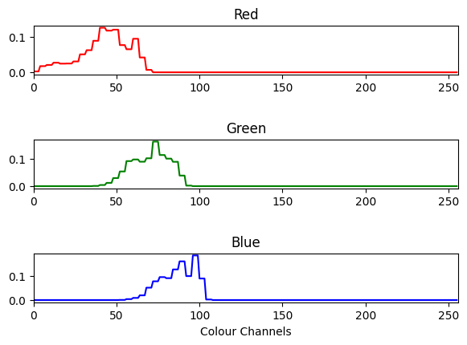
Histogram Of Colours in Sclera
Contrast Normalisation
64 Bins for histogram
Y values represents the frequency in portions
3 Channels
Flattened to produce feature vector of size 192

Slide 10
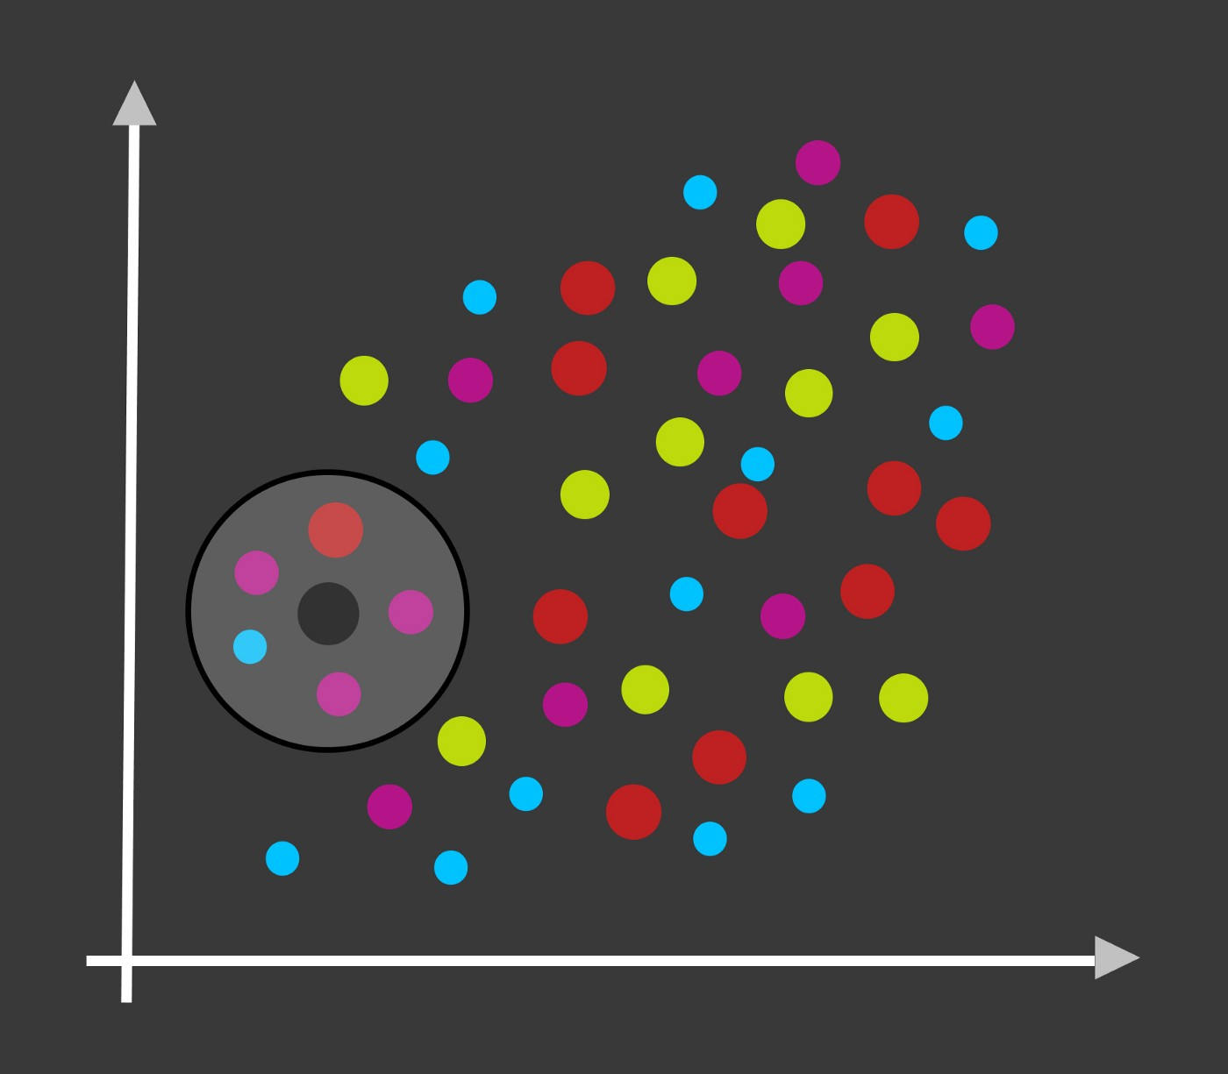
Classification of Typical and Atypical Sclera
K Nearest Neighbour Algorithm
Selects K number of nearest number of neighbours
Puts the new sample with the classes that has majority of neighbours
Note: Choose an odd number of K value
Histogram of RGB channels are fed to Train and Test
Train:
80% of each class
Augmented data samples for Osteogenesis Imperfecta and Jaundice
Test:
20% of each class

Slide 11
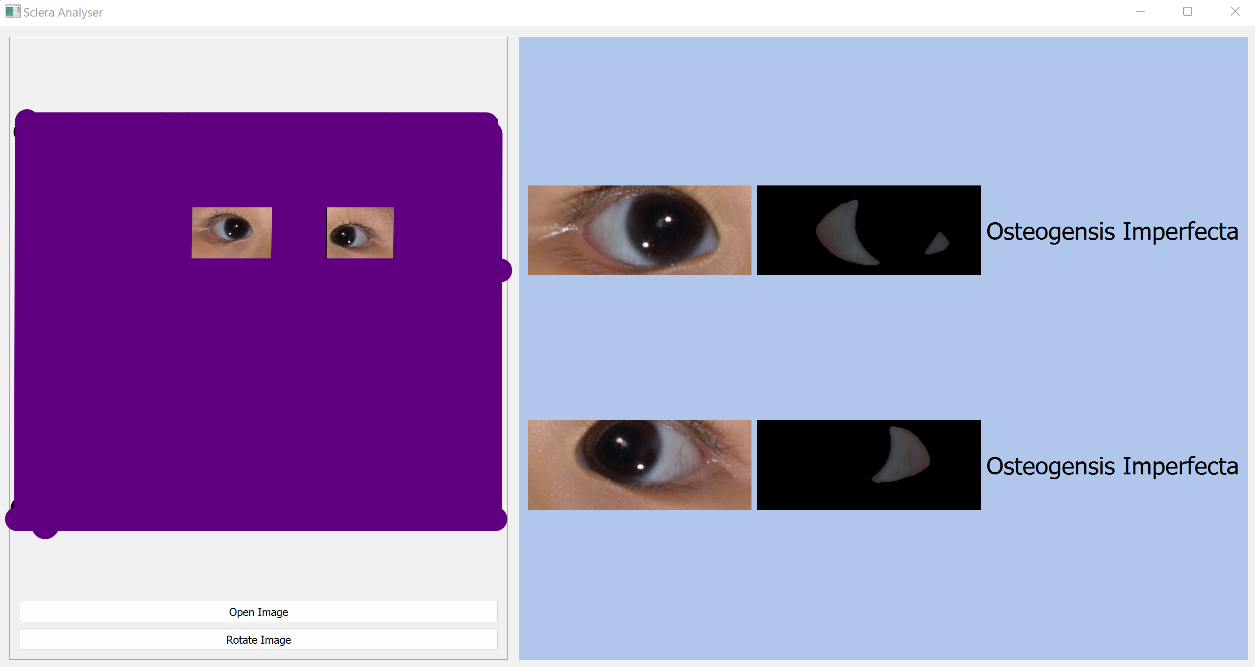
Demo Program

Slide 12
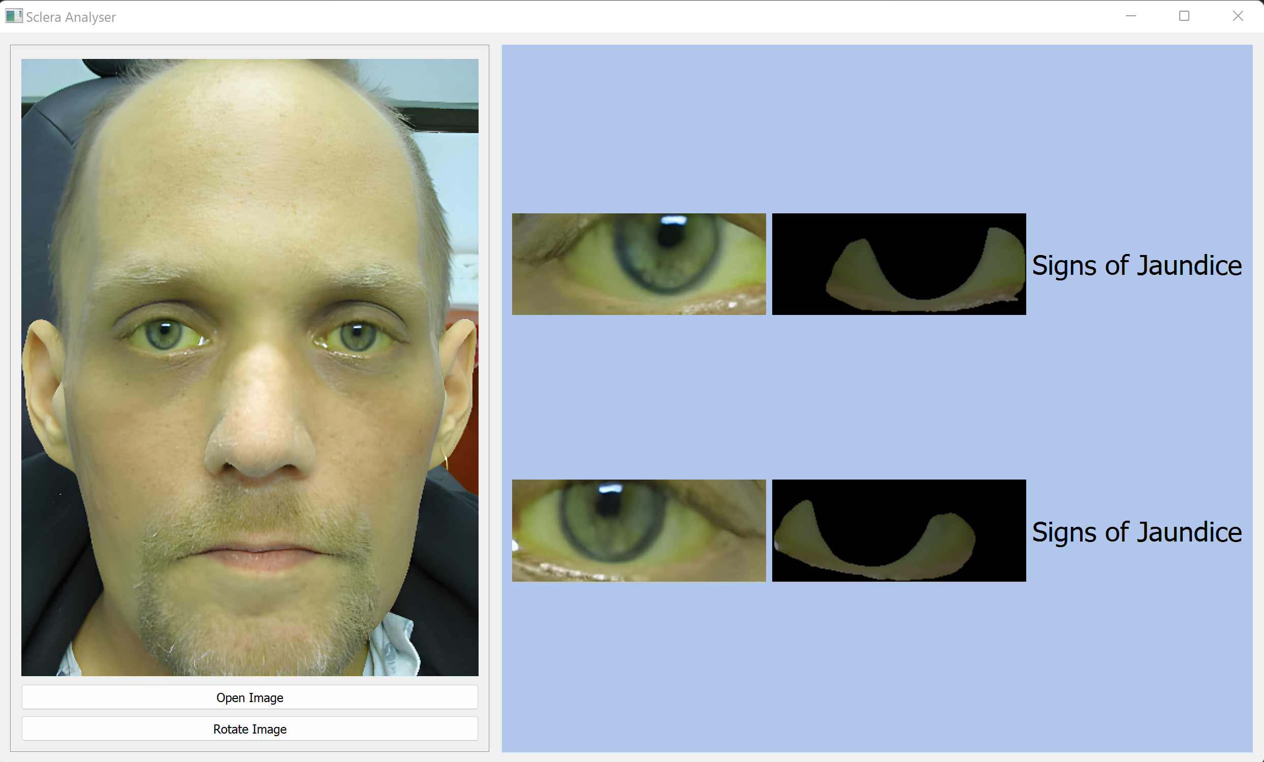
Demo Program

Slide 13
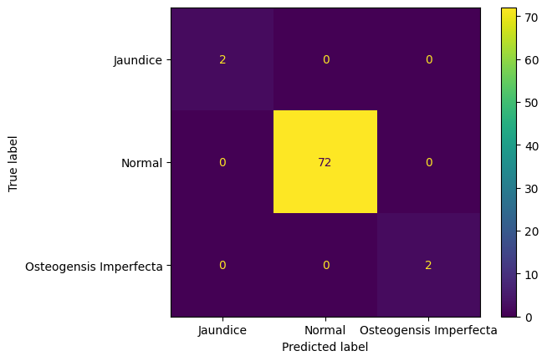
Results
Train: 450 images
Test: 74 images
10 Fold Cross Validation
Accuracy:
Train: 98%
Test: 100%
Optimal Number for K = 5
Precision: 1
Recall: 1
F1: 1

Slide 14
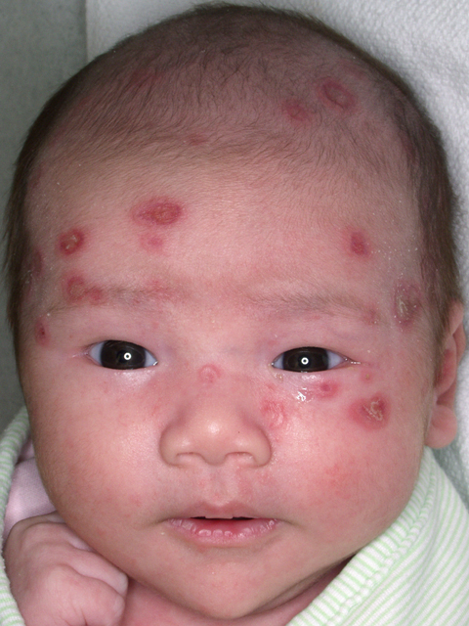
What about Skin Surface
Similar Process
Different Dataset and Annotation Required
Can also use other algorithms such as Support Vector Machine or Random Forest
Consider explainability and accuracy
Credit: Health Jade

Slide 15
Further Consideration
Implementing Attention UNet model to improve mask accuracy
Recruiting more patient who are affiliated with rare diseases
Explore different severity levels of rare diseases
Different Dataset and Annotation required
Investigate the impact of image quality on diagnosis
Look at HSV colour space

Slide 16
Conclusion
Introduced a novel deep learning framework
That can predict OI and Jaundice
Can be extended for numerous other conditions

Slide 17
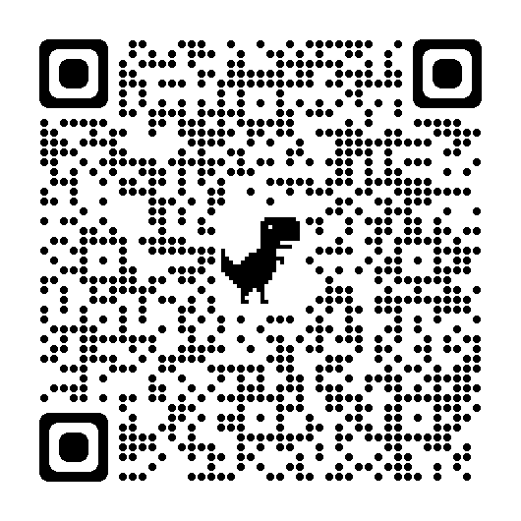




Code and Documentation
Open Source – Available on GitHub
Documentation – Available through Read The Docs

Slide 18
Acknowledgements
CIRB 2021/2419
Dr Saumya Shekhar Jamuar
Dr Tele Tan
Dr Lim Weng Khong
Charis Lim
Siti Na’ilah Binte Rahmat
Ms Simone Ng
Funding Source: Takeda
Dr Richard Palmer
Ms Sylvia Kam
Ms Lim Jiin Ying
Ms Jasmine Goh
Dr Sonia Davila
Ms Yasmin Bysltra
Cheri Chan

Slide 19
Questions?

Slide 20
Thank You!
Dev Patel

